Slide 1

An Empirical Evaluation of Distributed Key/Value Storage Systems
Vaishnavi Manjunath
Computer Science Graduate Student
Illinois Institute of Technology
vmanjunath@hawk.iit.edu
A20446043
Kalpana Pratapaneni
Computer Science Graduate Student
Illinois Institute of Technology
kpratapaneni@hawk.iit.edu
A20448916
Kavya Ravella
Computer Science Graduate Student
Illinois Institute of Technology
kravella@hawk.iit.edu
A20444960

Slide 2
Abstract
Key-Value Storage System:
What is Key-Value?
Advantages
High performance
Scalable
Reliable
Usage
Session Management
Real time recommendations and advertising
Purpose of this project

Slide 3
Motivation
System chosen:
Memcached
In-memory key-value store
Handles caching
MongoDB
BSON documents storage
Dynamic schemas
Riak
Distributed, fault tolerant key-value store
Request Handling

Slide 4
Proposed Work
Memcached
Client Hashing Algorithm
MongoDB
Sharding with replication
Riak
Clustering with internal replication

Slide 5
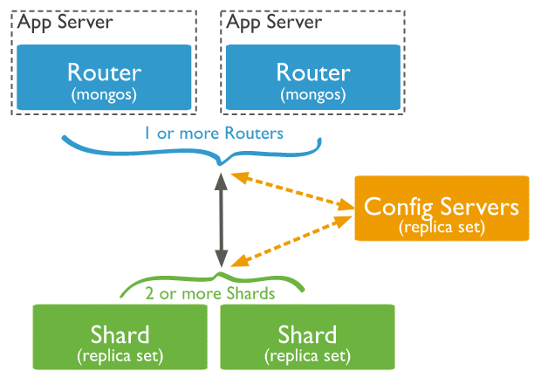
Proposed Work
MongoDB
sh.shardCollection( "hash_grp1.MyHashCollection", { "key" : "hashed" })

Slide 6
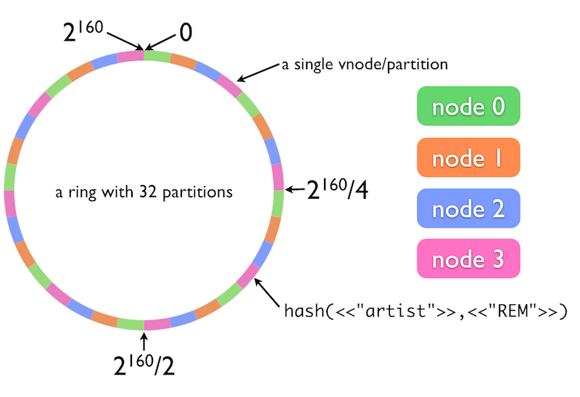
Proposed Work
Riak

Slide 7
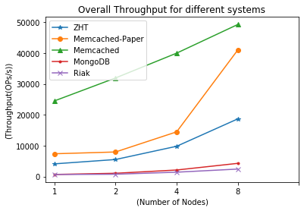
Evaluation
Throughput – Number of operations completed in a unit of time
 | 1-Node | 2-Node | 4-Node | 8-Node
ZHT | 4117 | 5524 | 9813 | 18680
Memcached-Paper | 7385 | 7961 | 14480 | 40995
Memcached | 24486.7687 | 31919.0688 | 39960.8064 | 49237.8867
MongoDB | 690.9691 | 1069.2928 | 2127.7476 | 4282.5387
Riak | 671.2157 | 764.8504 | 1421.4025 | 2433.0373

Slide 8
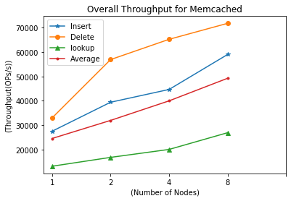
Memcached Evaluation
 | 1-Node | 2-Node | 4-Node | 8-Node
Insert | 27459.1826 | 39382.6688 | 44641.7511 | 59021.9516
Delete | 32909.7194 | 56910.4997 | 65241.8499 | 71815.9156
Lookup | 13091.4042 | 16730.7504 | 19998.8181 | 26875.7929
Average | 24486.7687 | 31919.0688 | 39960.8064 | 49237.8867

Slide 9
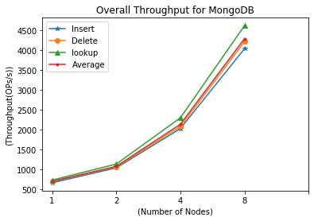
MongoDB Evaluation
 | 1-Node | 2-Node | 4-Node | 8-Node
Insert | 656.2216 | 1029.4237 | 2021.0983 | 4029.778
Delete | 692.7317 | 1051.6659 | 2071.3435 | 4206.589
Lookup | 723.954 | 1126.7887 | 2290.801 | 4611.249
Average | 690.9691 | 1069.2928 | 2127.7476 | 4282.539

Slide 10
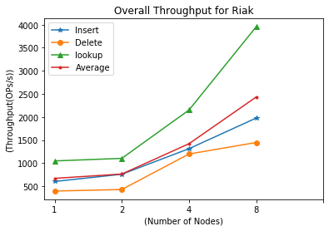
Riak Evaluation
 | 1-Node | 2-Node | 4-Node | 8-Node
Insert | 603.2988 | 760.6151 | 1314.0414 | 1977.5691
Delete | 396.5678 | 429.6999 | 1199.1317 | 1447.7331
Lookup | 1048.928 | 1104.2363 | 2151.0344 | 3953.8098
Average | 671.2157 | 764.8504 | 1421.4025 | 2433.0373

Slide 11
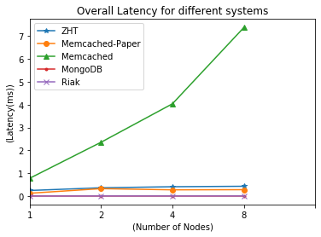
Evaluation
Latency – It presents the time per operation, round-trip request-response.
 | 1-Node | 2-Node | 4-Node | 8-Node
ZHT | 0.243 | 0.362 | 0.408 | 0.428
Memcached-Paper | 0.122 | 0.324 | 0.272 | 0.278
Memcached | 0.774 | 2.353 | 4.038 | 7.378
MongoDB | 0.001704 | 0.001838 | 0.001865 | 0.001949
Riak | 0.00156 | 0.00272 | 0.00309 | 0.00394

Slide 12
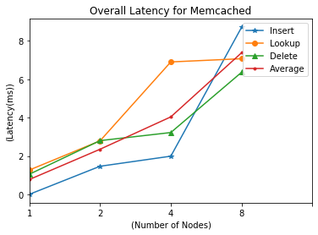
Memcached Evaluation
 | 1-Node | 2-Node | 4-Node | 8-Node
Insert | 0.004 | 1.467 | 1.992 | 8.705
Delete | 1.268 | 2.79 | 6.9 | 7.067
Lookup | 1.049 | 2.802 | 3.223 | 6.361
Average | 0.774 | 2.353 | 4.038 | 7.378

Slide 13
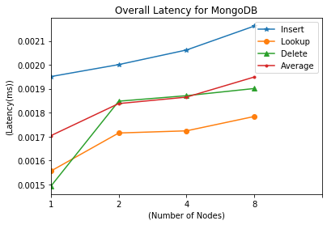
MongoDB Evaluation
 | 1-Node | 2-Node | 4-Node | 8-Node
Insert | 0.001951 | 0.002001 | 0.002062 | 0.002162
Delete | 0.001556 | 0.001715 | 0.001724 | 0.001784
Lookup | 0.001493 | 0.001848 | 0.001871 | 0.001901
Average | 0.001704 | 0.001838 | 0.001865 | 0.001949

Slide 14
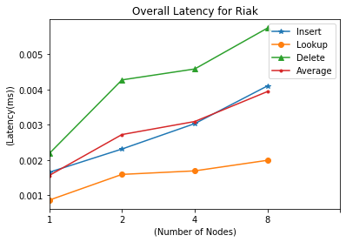
Riak Evaluation
 | 1-Node | 2-Node | 4-Node | 8-Node
Insert | 0.00165 | 0.00231 | 0.00303 | 0.0041
Delete | 0.00086 | 0.00159 | 0.00169 | 0.00199
Lookup | 0.00218 | 0.00427 | 0.00458 | 0.00574
Average | 0.00156 | 0.00272 | 0.00309 | 0.00394

Slide 15
Conclusion
In terms of fault tolerance and scalability Riak and MongoDB has better performance
Overall throughput and latency remained consistent even with multiple nodes and different request operations

Slide 16
References
http://pages.cs.wisc.edu/~vijayc/papers/memcached.pdf
https://docs.mongodb.com/manual/sharding/
Riak, 09 2011, [online] Available: http://basho.com/Riak.html

Slide 17
Thank You

